Slide 1
Structural Design Patterns

Slide 2
What is Structural Patterns
Explain How to build larger structure by combining classes and objects.
Focus on the relationships between components, not the behavior inside him
Encourage Composition over Inheritance

Slide 3
Structural Patterns Pros
Help simplify complex class and object structures.
Make code more reusable, flexible, and easier to maintain.
Support composition over inheritance to reduce tight coupling.
Decouple implementation from interface for better modularity.
Make large systems easier to understand and extend.

Slide 4
Structural Patterns
Adapter
Decorator
Composite
Façade
Proxy
Bridge
Flyweight

Slide 5
Adapter Pattern

Slide 6

Charger With 2 pins
I love you
Socket with 3 holes
You are not my type

Slide 7
Adapter: Problem
Two classes cannot work together because their interfaces are incompatible.
You need to use an existing class (legacy code, library, API) but cannot change its interface.
The client expects a different method format, naming, or structure.
Changing either side would cause code breakage, duplication, or violate the Open–Closed Principle.

Slide 8
Adapter: Solution
Creates a middle class (the Adapter) that sits between the client and the existing class.
The Adapter implements the interface the client expects.
Inside, the Adapter translates the client’s calls into the format the existing class understands.
The client interacts only with the Adapter
No changes are required in either the client or the existing class → loose coupling.
Allows integration of legacy code, third-party libraries, or incompatible modules smoothly.

Slide 9

Adapter
Let me handle it, Stupid
I like you
Socket with 3 holes
Charger With 2 pins
I love you
You are my type, moah

Slide 10
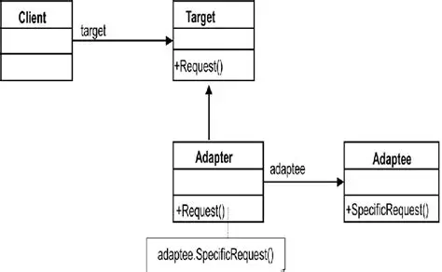
Adapter: Class Diagram

Slide 11
Hands On

Slide 12
Adapter: Pros
Reuses existing code without modifying it.
Makes incompatible classes work together seamlessly.
Supports the Open–Closed Principle (add new adapters without changing existing classes).
Improves flexibility by allowing multiple adapters for different interfaces.
Simplifies integration of legacy systems and third-party libraries.

Slide 13
Adapter: Cons
Can add an extra layer of complexity or indirection.
Too many adapters may lead to messy architecture if not managed well.

Slide 14
Decorator Pattern

Slide 15
Inheritance Approach Problem
Coffee
Cost = 5
Milk
Cost = cost + 2
Sugar with Milk
Cost = cost + 3
Sugar
Cost = cost + 1

Slide 16
Decorator: Problem
You want to add new behavior to objects dynamically, without changing their original code.
Using inheritance for every combination of features leads to a class explosion.
You need a flexible way to mix and match responsibilities at runtime.
The goal is to extend functionality without modifying existing classes.

Slide 17
Decorator: Solution
Wrap the original object inside another object (a decorator) to add new behavior.
Each decorator adds one feature, and decorators can be stacked on top of each other.
No need to modify existing classes → Open/Closed Principle.
No need for many subclasses → avoid inheritance explosion.
Features can be added dynamically at runtime, not fixed in class design.
Flexible: any combination of features can be created by simply wrapping objects.

Slide 18
Decoration Approach
Milk
Cost = cost + 2
Sugar
Cost = cost + 1
Coffee
Cost = 5
Milk
Cost = cost + 2
Coffee
Cost = 5
Sugar
Cost = cost + 1
Coffee
Cost = 5

Slide 19
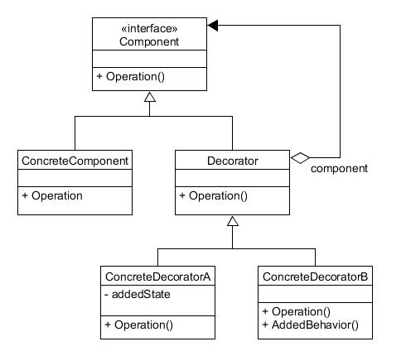
Decorator: Class Diagram

Slide 20
Hands On

Slide 21
Decorator: Pros
Adds new behavior dynamically without modifying existing code.
Avoids class explosion caused by too many subclasses.
Follows the Open/Closed Principle (open for extension, closed for modification).
Allows flexible combinations of features at runtime.
Decorators are independent and can be reused across different objects.
Keeps classes small and focused by separating features into individual decorators.
Easy to add new features by creating new decorators.

Slide 22
Decorator: Cons
Can introduce too many small classes (one for each feature).
Debugging can be harder because behavior is split across many wrappers.
The final behavior may be hard to trace, especially with multiple decorators stacked.
Order of decorators matters, which can introduce subtle bugs.
Increased complexity compared to simple inheritance.

Slide 23
Break

Slide 24
Façade Pattern

Slide 25

Problem: Ex..
GPU
User Program
Memory
Disk
CPU

Slide 26
Problem: Ex..
Memory
readFromPA()
writeTo()
enableIntr()
disableIntr()
managePipelines()
allocatePF()
manageTLB()
mapPage()
unmapPage()
User Program
I just want a space
Take them all, don’t be a headache

Slide 27
Façade: Problem
Large systems contain many complex subsystems
Client code must interact with many different APIs, each with its own rules.
Leads to high coupling between the user program and internal components.
Small change in any subsystem can break the entire program.
The client must understand low-level details to perform simple tasks.
Code becomes hard to maintain, test, or extend.

Slide 28
Façade: Solution
Introduce a single, simplified interface (Facade) for the client to use.
The Facade hides the complexity of multiple subsystems.
Client interacts with one unified API, not many scattered ones.
Internal components can change freely without affecting the client.

Slide 29

Façade Solution
GPU
User Program
Memory
OS
Disk
CPU

Slide 30
Façade Solution
Memory
readFromPA()
writeTo()
enableIntr()
disableIntr()
managePipelines()
allocatePF()
manageTLB()
mapPage()
unmapPage()
User Program
I just want a space
OS
Let me handle it

Slide 31
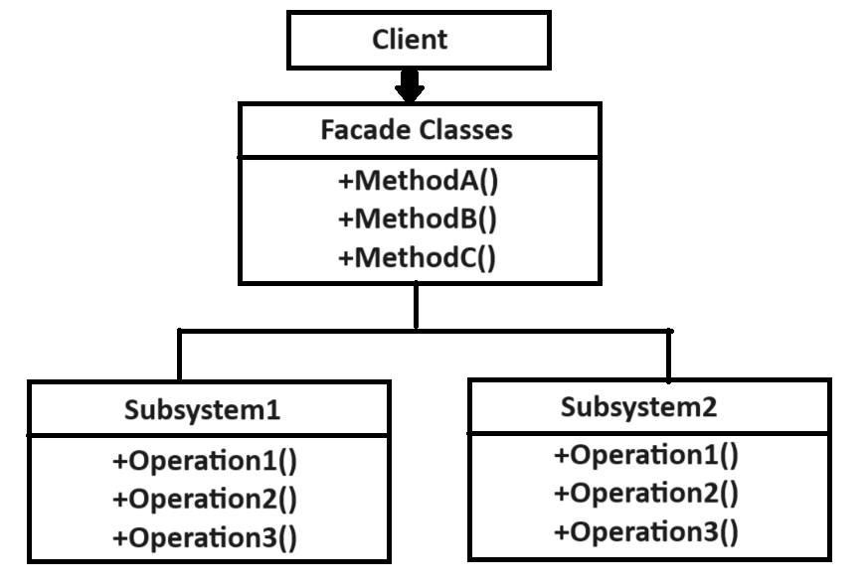
Façade: Class Diagram

Slide 32
Hands On

Slide 33
Façade: Pros
Subsystems can change internally without breaking client code.
Simplifies usage by providing one unified, high-level interface.
Reduces coupling between client code and complex subsystems.
Makes the system easier to maintain, extend, and refactor.
Subsystems can change internally without breaking client code.
Improves readability and keeps client code clean and focused.
Helps enforce separation of concerns.
Provides a clear entry point to a large or messy system.

Slide 34
Façade : Cons
Facade can become a god object if it grows too large.
Too much hiding may restrict advanced functionality from the client.
Changes in the facade interface may require changes in the client.
May add extra layer of abstraction, even when not necessary.
Can accidentally duplicate functionality if not designed carefully.

Slide 35
Composite Pattern

Slide 36
Composite: Problem
Need to treat individual objects and groups of objects in the same way.
Client code becomes complicated with if-else checks (is it a single item or a group?).
Hard to manage tree-like structures manually (folders, UI components, game objects, shapes, etc.).
Adding new element types requires changing client code, violating Open–Closed Principle.

Slide 37
Client
Single Node
Group of Node
Single Node
Single Node

Slide 38
Client
Component
Leaf
Composite
Leaf
Leaf
Composite

Slide 39
Façade: Solution
Defines a common interface for both simple (Leaf) and composite (Container) objects.
Allows building tree structures of any depth using the same type.
Client interacts with all objects through a single unified interface.
Composite objects store and manage children, while Leaf objects perform real actions.
Supports adding new element types without modifying existing code.

Slide 40
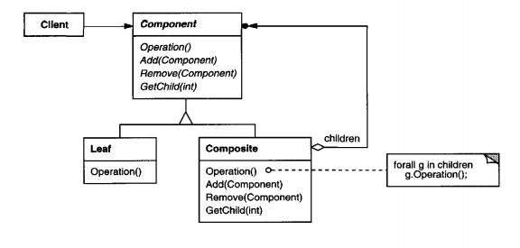
Composite: Class Diagram

Slide 41
Hands On

Slide 42
Composite: Pros
Subsystems can change internally without breaking client code.
Greatly simplifies client code — one interface for everything.
Makes tree structures easy to build, traverse, and manage.
Encourages Open–Closed Principle — new components fit naturally.
Supports flexible and scalable hierarchical designs..

Slide 43
Façade : Cons
May allow invalid operations
Debugging becomes harder
Changes in the facade interface may require changes in the client.

Slide 44
Thank You

